Slide 3
Pierre-Charles L’Enfant | Benjamin Banneker | Daniel Boone | Christopher Columbus | Don Juan de Oñate
Henry Ford | Mary Kay Ash | Wallace Amos | Milton Hershey | Sam Walton
Rosa Parks | Helen Keller | Clara Barton | Ruby Bridges | Hector P. Garcia
James A. Lovell | Harriet Tubman | Juliette Gordon Law | Todd Beamer | Ellen Ochoa
John “Danny” Olivas | Phyllis Wheatley | Tomie de Paola | Carmen Lomas Garza | Laura Ingalls Wilder
Bill Martin Jr. | Jonas Salk | Cyrus McCormick | Bill Gates | Louis Pasteur
 |  | Dr. Martin Luther King Jr.

Slide 10
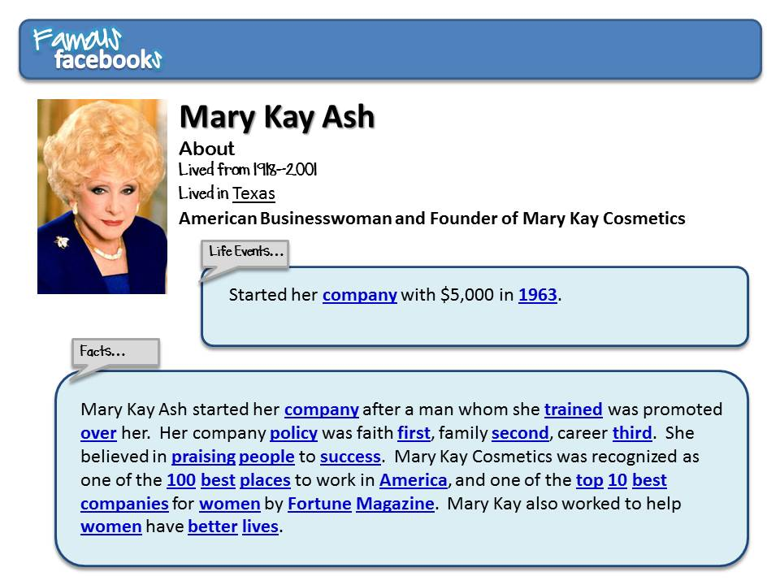

Slide 13
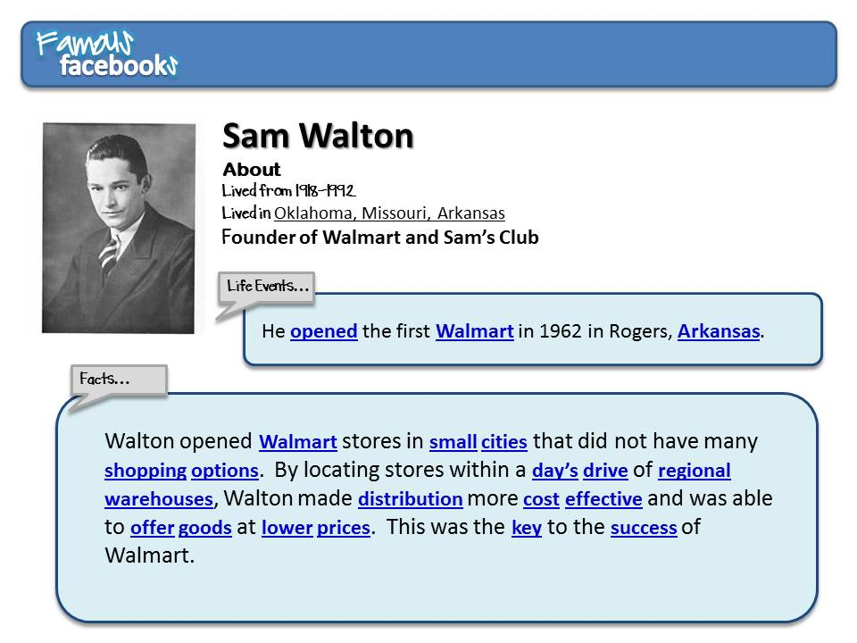

Slide 18
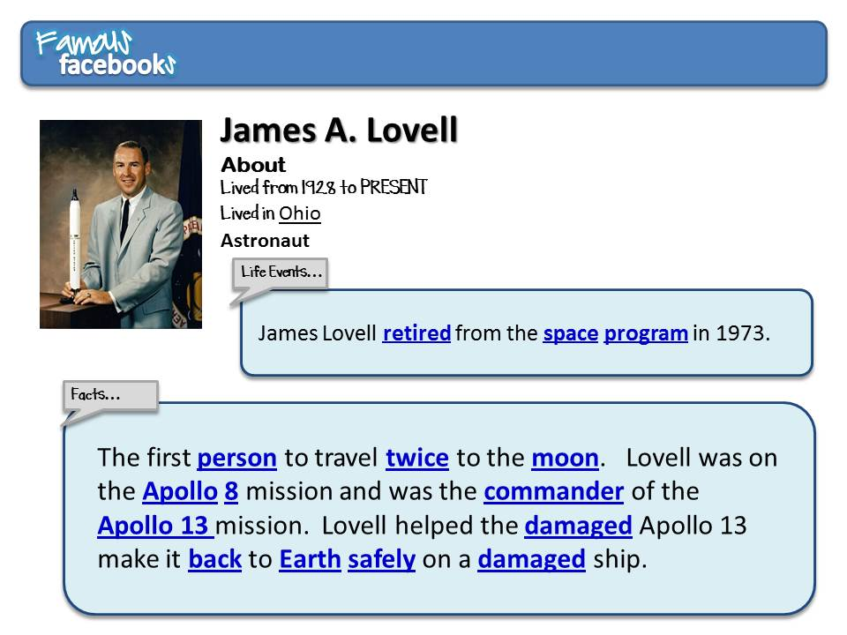

Slide 20
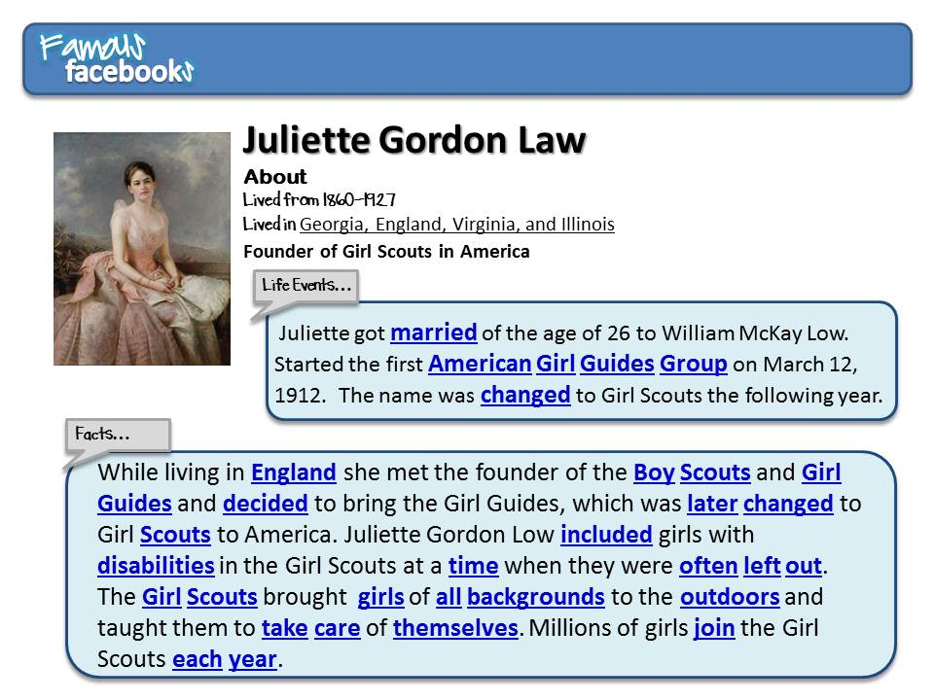

Slide 21
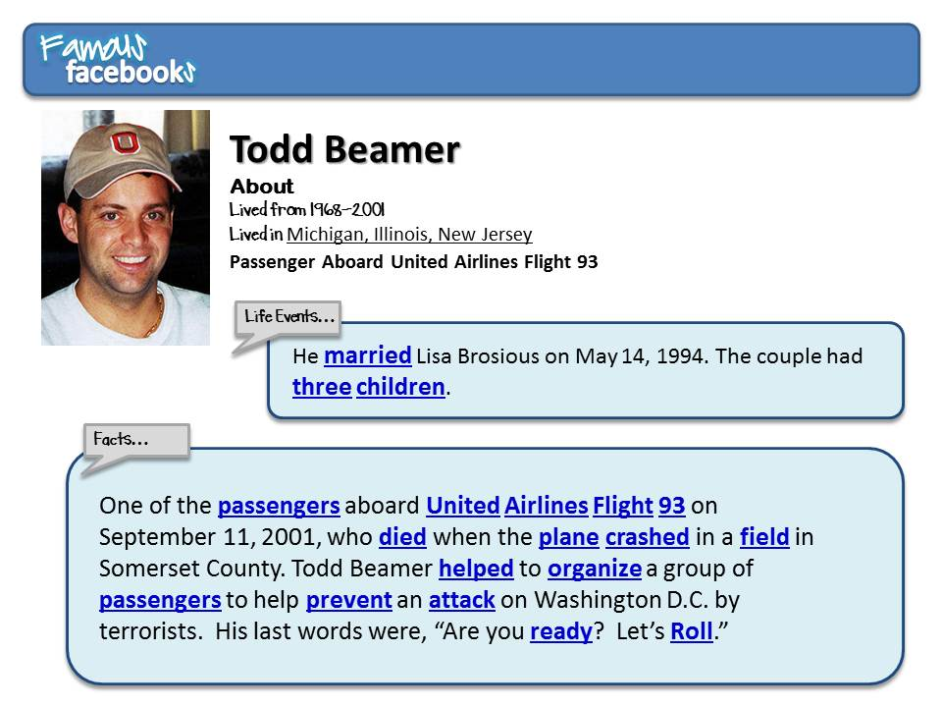

Slide 23
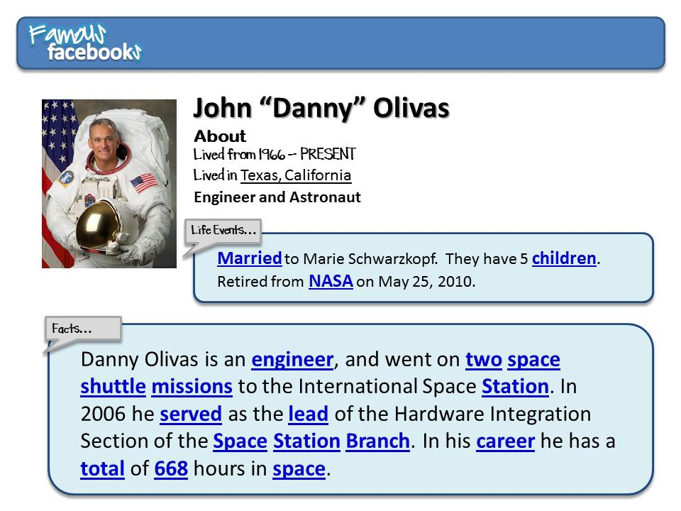

Slide 24
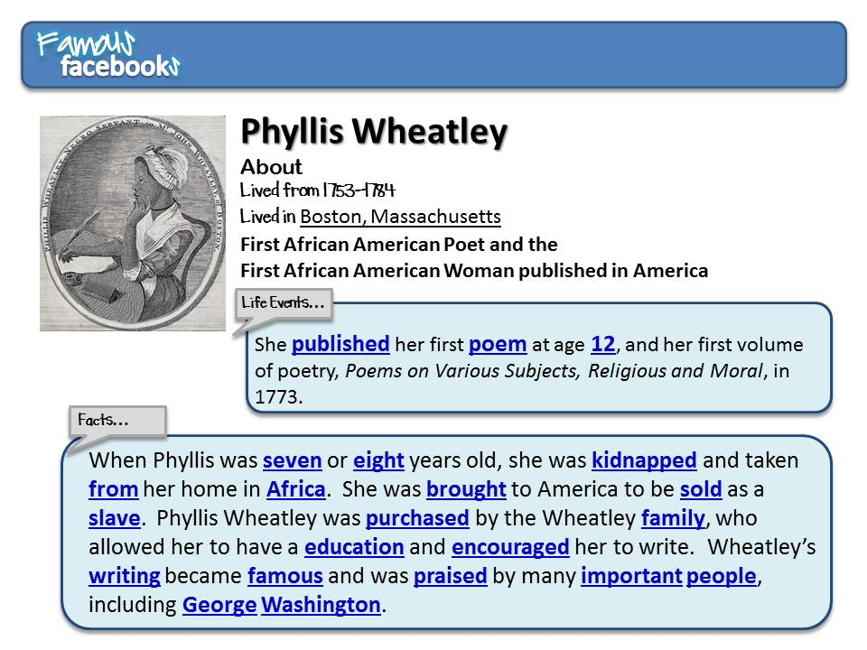

Slide 27
